Slide 1
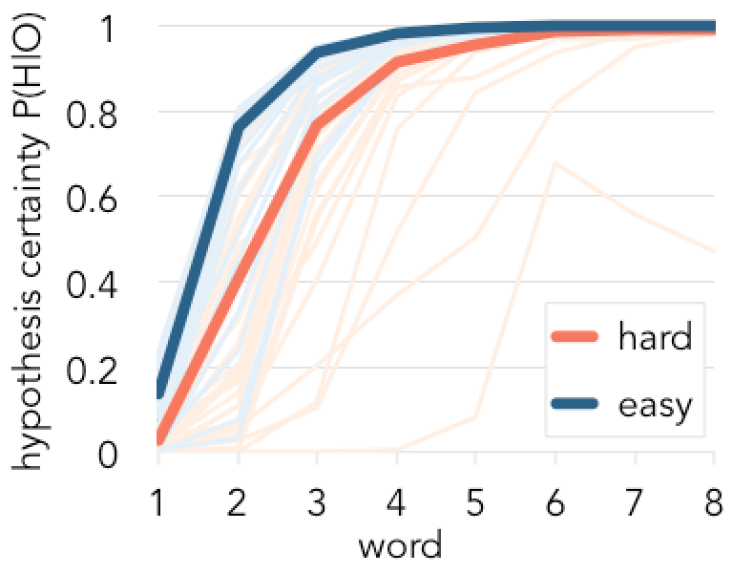
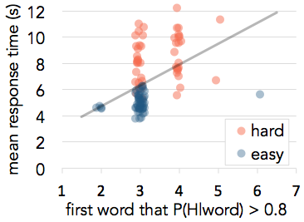
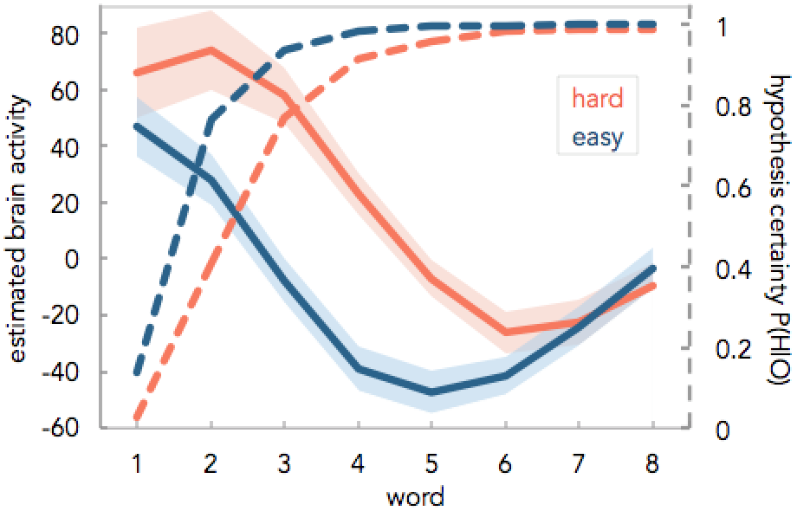
Title goes here (pt. 90)
Author, Author, & Author (pt. 60) (add spaces here to create the right amount of padding) Department, University
Introduction
Results
Some More Results
Concisely summarize background information and use references where needed.¹ (pt. 40)
Describe the goals and predictions of the project.
FIGURE 1: Description of figure goes here. Be concise but descriptive.
FIGURE 2: Word sets that have low predicted certainties tend to be solved slowly. The line of best fit is shown in gray.
◀
◀
Methods
More Results
Briefly describe the stimuli and methods. Use pictures instead of words where possible.
When you change the section header, resize the text box so that the amount of white space on either side of the header is consistent with the other headers. Place the header in the center of the top line.
You can use the navy, coral, and gray colors to represent different conditions.
font family: Avenir
color scheme:
navy
coral
gray
#1E4E79
#F5584E
#BBCACD
Summary
These figures were made in Excel and then copied and pasted in. If you do it this way, make sure that you make the text in the figures big enough so that when you add it to the poster the text is around the same size as the paragraph text. Also make sure the resolution is high enough so that it doesn’t look grainy when it is printed.
Restate the big picture of the results and discuss conclusions and future work.
◀
FIGURE 4 Brain activity in the inferior frontal sulcus (white ROI in FIG 3) is high when the predicted hypothesis certainty is low.
References
Last, Firstname (Year). Title. Journal. (pt 24)
Last, Firstname (Year). Title. Journal.
Last, Firstname (Year). Title. Journal.
logo 1
This research was funded by…
logo 2
name@university.edu

