Slide 1
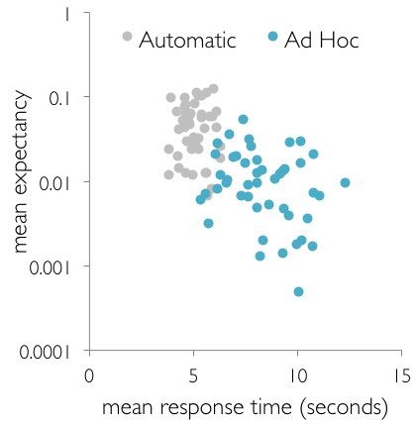
Title goes here (pt. 88)
Author, Author & Author (pt. 54)
Department, University (pt. 54)
Introduction (pt. 60)
Results
At the end of each trial, the correct category was revealed and the subjects recorded the accuracy of their category guess.
More Results
Briefly introduce your topic.^{1,2,3} (pt. 44)
Explain your results. Here are examples of figure formatting:
Automatic
Emphasize the goal of the study.
Ad Hoc
r² = 0.41
p < 0.001
The charts were made with Excel. The fonts for the axes, labels, and legend are Gill Sans Light, pt 20-24. The gray and turquoise colors are included in the default Office color scheme.
Discussion
Methods
Summarize your results & talk about the big picture.
Describe stimuli and methods. Use figures where possible.
Discuss limitations or future work.
Different Results
References
Lastname, F. (2000). Title of article. Journal., Volume, page-page.
Lastname, F. (2000). Title of article. Journal., Volume, page-page.
Lastname, F. (2000). Title of article. Journal., Volume, page-page.
Logo 1
This research was funded by….
Logo 2
email@university.edu
Notes:
Behavioral results: make bar graphs of RT?
fMRI results: labels, figure caption, make blues in graph the same color
References: add marcel 2004, add numbers, rearrange

